Slide 1
Module 3: The Bitome - Genome Analysis and Machine Learning
Part 1: Quantifying the information in a bacterial genome sequence

Slide 2




Acknowledgements: The Bitome Team
Cam Lamoureux, PhD student
Organized genomic data in the Bitome
Multi-strain and ALE analysis of the extended Bitome
Sizhe Qiu, BS/MS student
Developed an ML model to understand ICA membership
Patrick Phaneuf, PhD student
3D protein structure analysis of ALE mutations
Dan Zielinski, Scientist
Project supervisor and gene sequence enthusiast
And more!
Many undergraduates rotating in the lab working on sequence modeling projects

Slide 3
Outline
What is in a DNA sequence?
Transcriptional Unit
Prokaryotic Vs. Eukaryotic TUs
Prokaryotic Vs. Eukaryotic mRNA
Experimental methods to determine TU components
Regulons, Stimulons and TRNs
Towards mathematical interpretation of sequences: The concept of Bitome
Notes:
As a quick outline we will through what information is there is a DNA seq which is basically a transcriptional unit

Slide 4
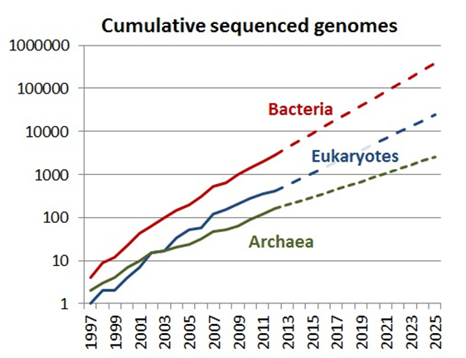
Sequencing data overload
Exponential increase in the sequencing data each year
A major challenge is to understand what the genome contains and how the genome functions.
Notes:
The former is addressed by a combination of computer analysis and experimentation, with the primary aim of locating the genes and their control regions. The second question - understanding how the genome functions - is, to a certain extent, merely a different way of stating the objectives of molecular biology over the last 30 years.

Slide 5
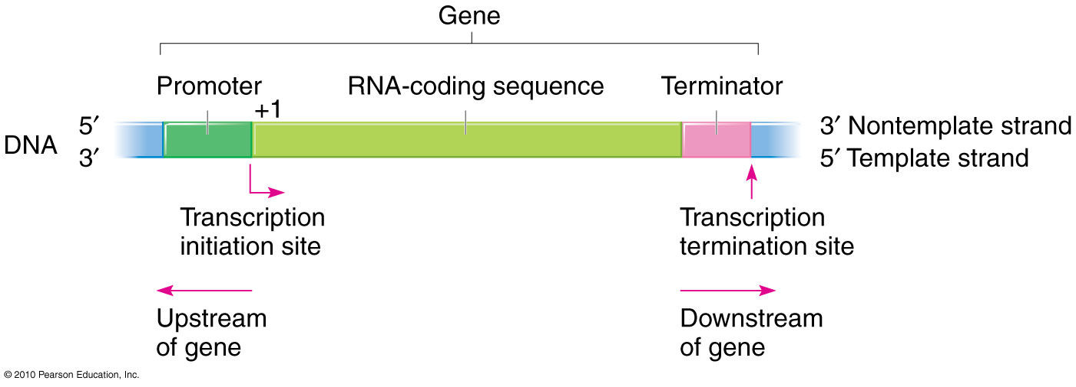
Transcriptional Units (TUs)
Genomic DNA sequences can organized in terms of TUs
TUs include: Promoters, Transcription start site, coding region and transcription termination site
https://www.mun.ca/biology/scarr/iGen3_05-03.html
Notes:
template strand is the the coding strand whose base sequence corresponds to the base sequence of the RNA transcript produced.

Slide 6
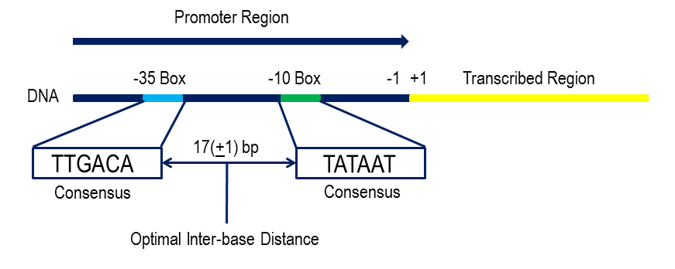
Prokaryotic TUs
Two conserved sequences at -10 and -35 bp upstream of transcription start site.
recognised by sigma subunit of RNA polymerase
Notes:
prok TU consists of two main consensus sequence at -10 and -35 bp

Slide 7
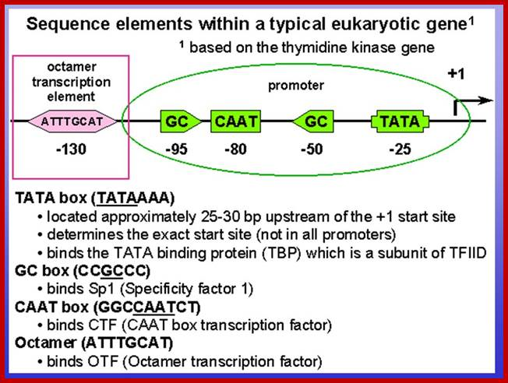
Eukaryotic TU
TATA box: initiates the transcription of gene
form part of core promoter region
The CAAT, GC box: located close to promoter
binds a specific protein
modulates transcription
Octamer transcription element: bound by octamer binding proteins
Core promoter
https://slideplayer.com/slide/4941341/

Slide 8
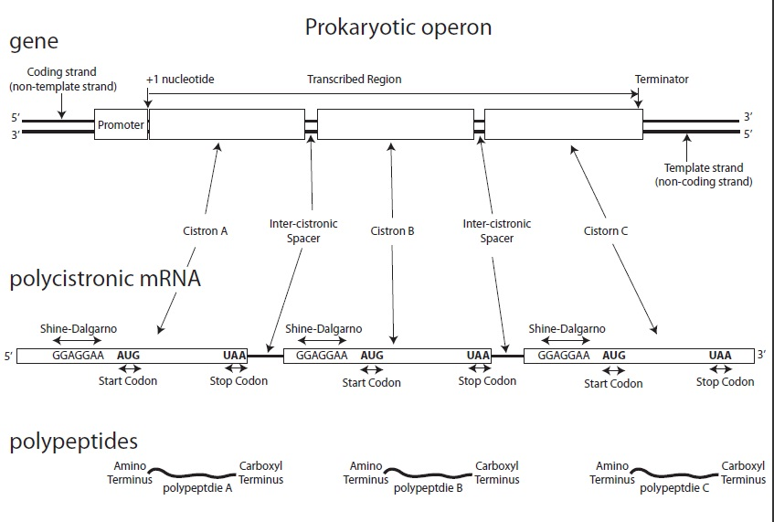
Prokaryotic mRNA and operons
Polycistronic mRNA
3 regions: 5’UTR, coding region and 3’UTR
Each gene in operon with their own Shine-Dalgarno sequence
http://askmissteong.blogspot.com/2012/09/1-comparison-between-prokaryotic-mrna.html
Notes:
prokaryotes may have polycistronic transcriptional unit meaning 'a cluster of adjacent genes being co-transcribed' into a single RNA.
each gene of the operon are translated into corresponding proteins with their own shine dalgarno seq. which is imp for ribosome binding
The 5′ untranslated region (5′ UTR) (also known as a leader sequence or leader RNA) is the region of an mRNA that begins at the transcription start site and ends one nucleotide (nt) before the initiation sequence (usually AUG) of the coding region.
contains a (RBS), also known as the Shine Dalgarno sequence (AGGAGGU), which is usually 3-10 base pairs upstream from the initiation codon

Slide 9
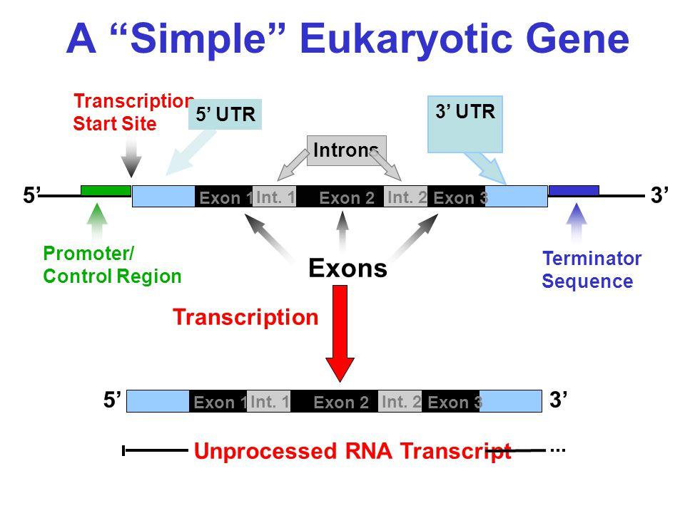
Eukaryotic mRNA
Monocistronic mRNA
3 regions: 5’UTR, coding region and 3’UTR
RNA divided into exons (coding) and introns (non-coding)
http://www.mun.ca/biology/desmid/brian/BIOL2060/BIOL2060-23/CB23.html
Notes:
In contrast, the eukaryotic 5′ UTR contains the Kozak consensus sequence (ACCAUGG), which contains the initiation codon.^{[5]} The eukaryotic 5′ UTR also contains cis-acting regulatory elements called upstream open reading frames (uORFs) and upstream AUGs (uAUGs) and termination codons, which have a great impact on the regulation of translation (see below).
section of messenger RNA (mRNA) that immediately follows the translation termination codon.
The poly(A) tail contains binding sites for poly(A) binding proteins (PABPs). These proteins cooperate with other factors to affect the export, stability, decay, and translation of an mRNA.

Slide 10
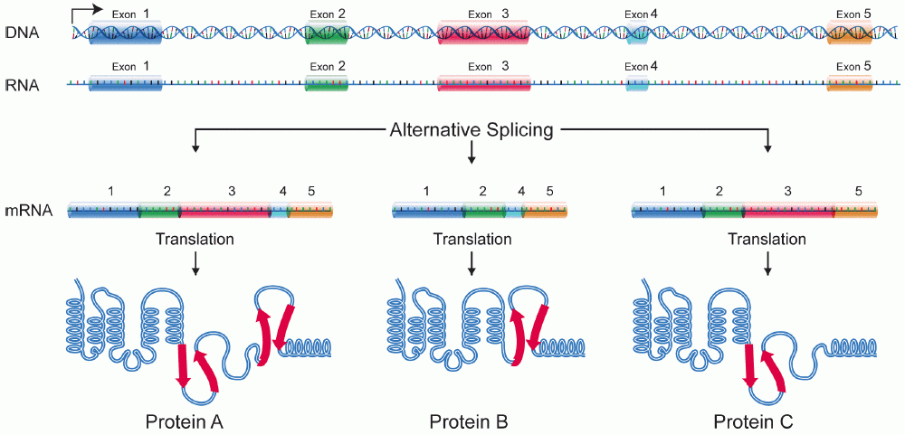
Example of complex eukaryotic mRNA
Introns are removed to form mature mRNA
Different combination of exons to produce different mRNA and protein products
Notes:
diff combination of exons to produce different mRNAs and hence different protein product

Slide 11
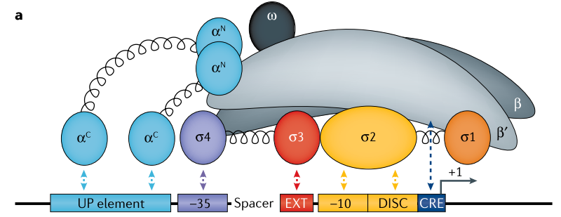
The Transcription Start Site
Defines the upstream end of a transcription unit (TU) and the downstream end of a promoter
Classic conserved sequence elements in the promoter contribute to transcription initiation
-10 (Pribnow) box
-35 box
These are sigma factor binding sites
Arguably amongst the most important locations in the genome
Mejia-Almonte et al (2020) Nature Reviews Genetics

Slide 12
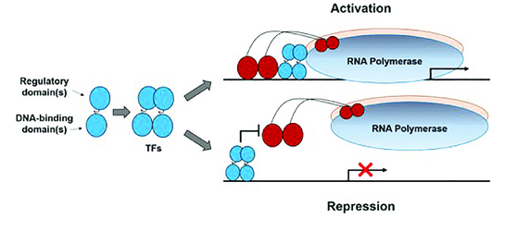
Regulation of Transcription Initiation
RNA Polymerase
σ factor
-35 Region
pribnow(-10)
+1
Transcription start site
Sigma factor recognizes promoter sequence, enables RNAP binding, and then initiate transcription.
TF binds to promoter sequence to regulate the transcription rate, repression or activation. The interactions between regulators and genes form the transcription regulatory network, which could be determined by ChIP-seq experiments or independent component analysis.
Notes:
The organism in this study is E. coli

Slide 13
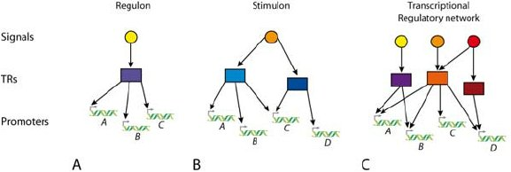
Regulons, Stimulons and TRNs
TUs contain information about TFs
Regulon: A single environmental signal can act on many promoters to regulate the expression of related gene clusters (A, B, C, and so on)
Stimulon: A given environmental acts on various TRs
TRN: A set of signals, act on various signals and hence a wide array of gene clusters
Adaptive Responses by Transcriptional Regulators to small molecules in Prokaryotes Structural studies of two bacterial one-component signal transduction systems DntR and HpNikR, Thesis: Cyril Dian
Notes:
TF that bind to promoters to either up regulate or down regulate transcription of gene

Slide 14

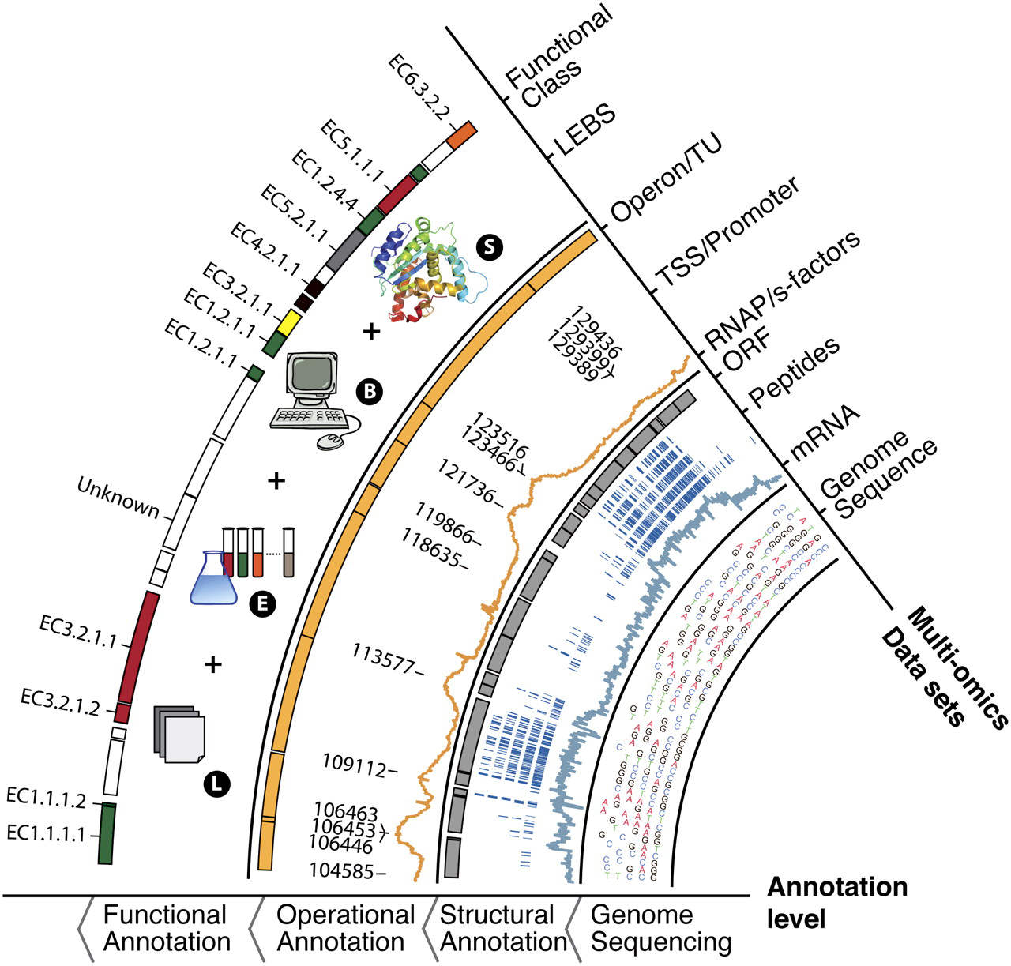
Metastructure of the genome
Organizational levels:
Functional annotation
Operational annotation
Structural annotation
Genome Research, 20:1304–1311, 2010.
Notes:
metastruc inc str, func, operational annotation. the data includes genome seq,

Slide 15
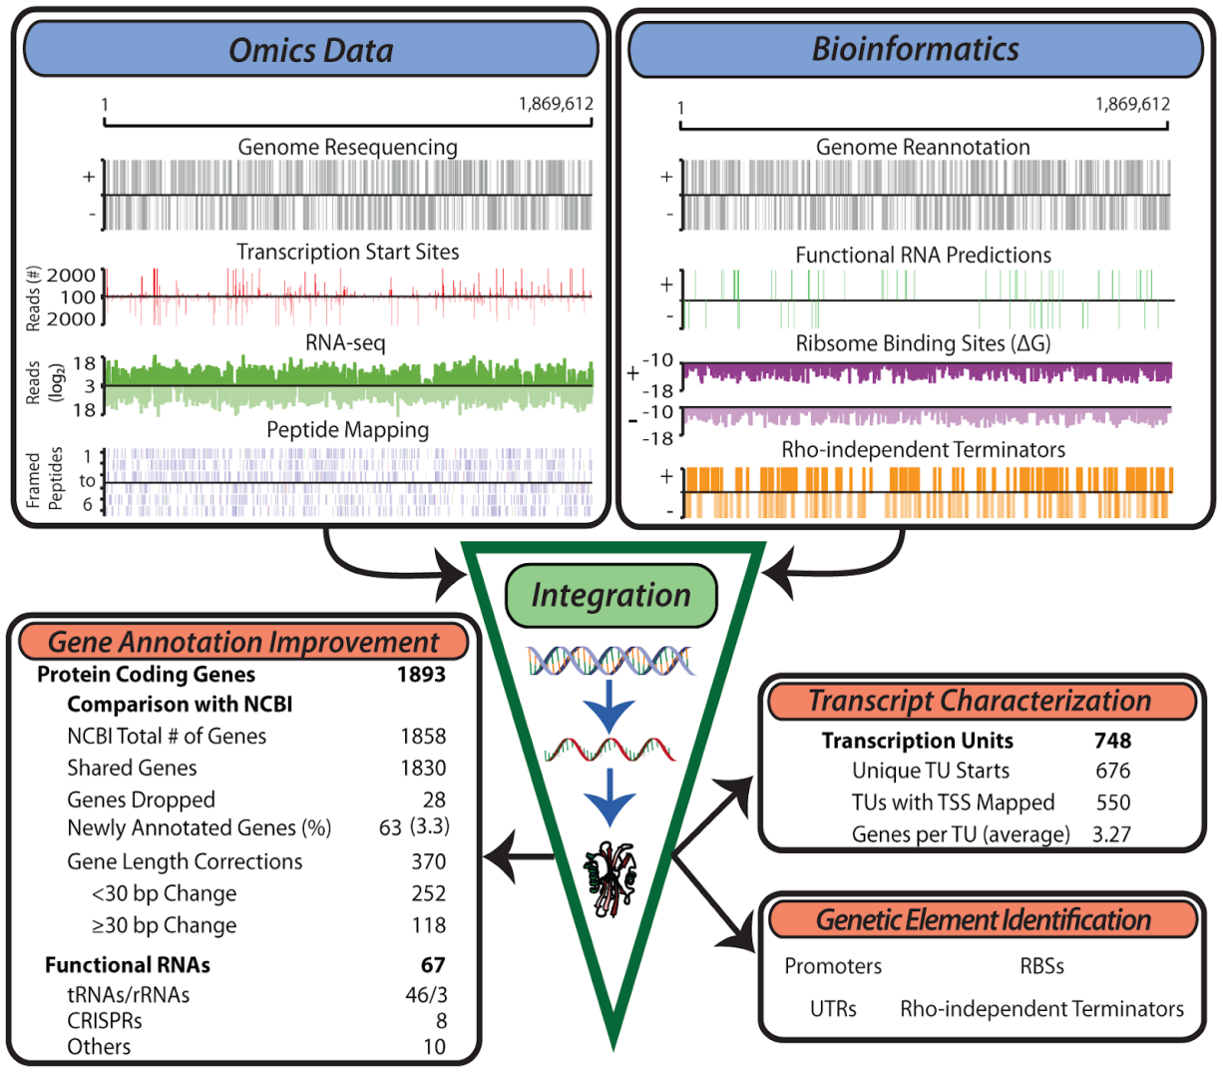
Multi-omics data integration
Data from experimental and computational methods can be integrated to uncover the fundamental architecture of the genome and biological regularities
Latif*, Lerman* et al. PLOS Genetics (2013)

Slide 16
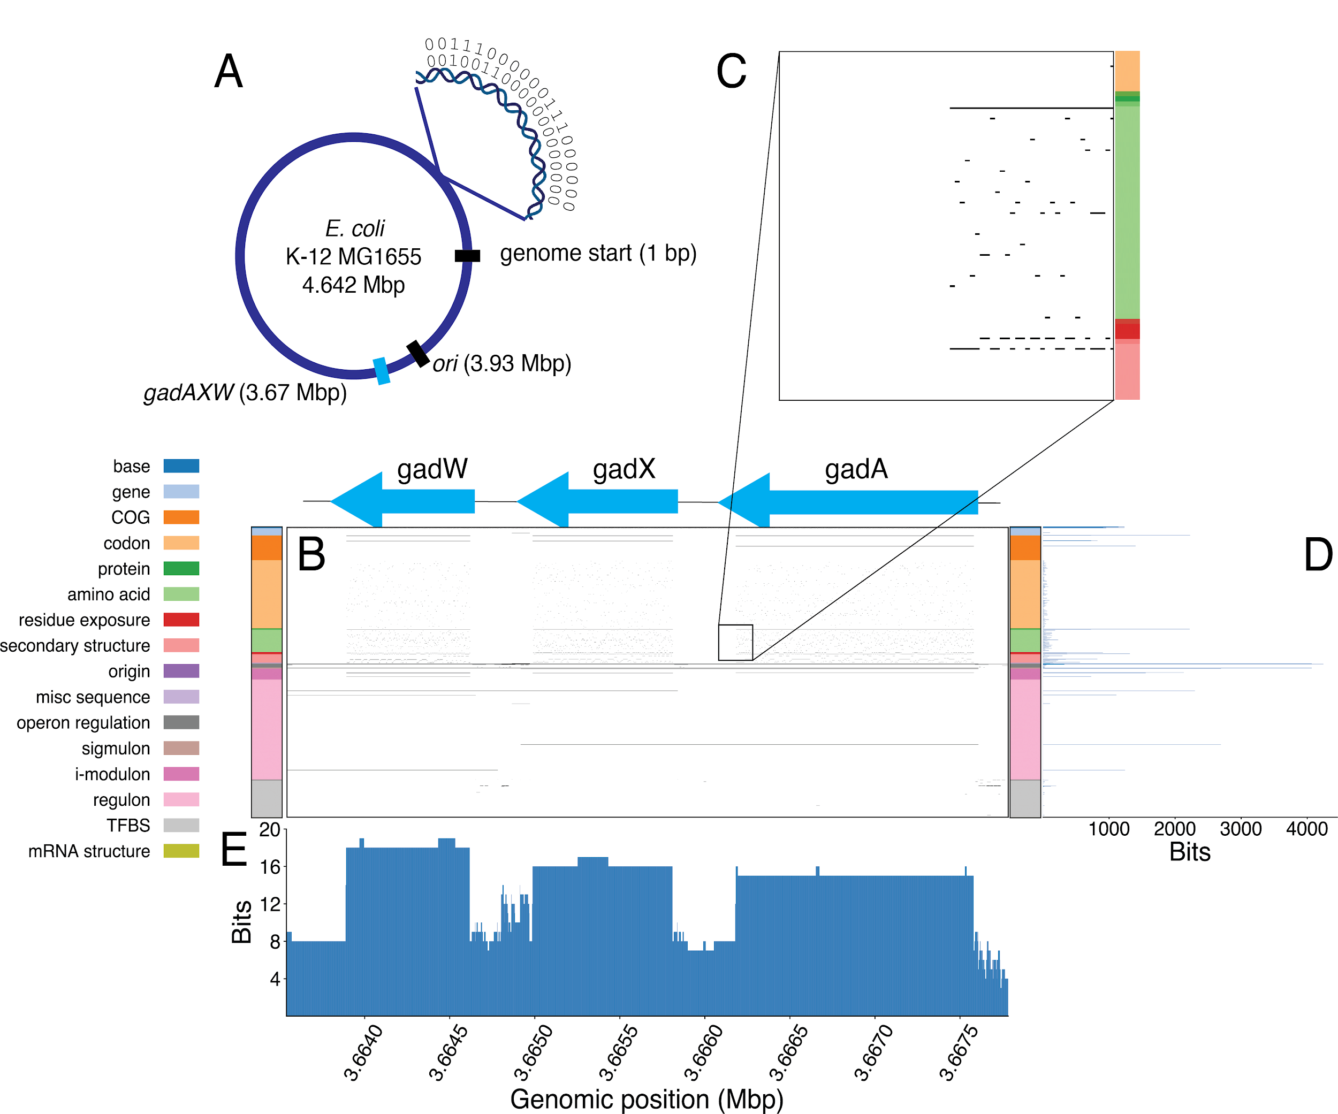
The Bitome: Experimental Data mapped to the genome
https://academic.oup.com/nar/article/48/18/10157/5911745

Slide 17
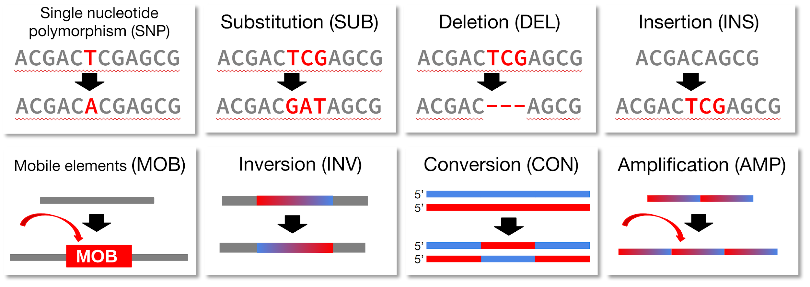
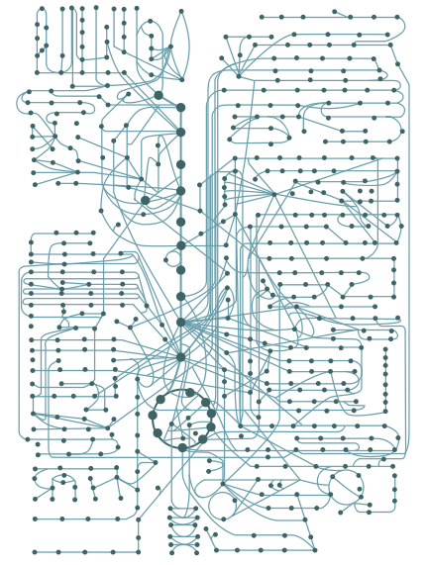
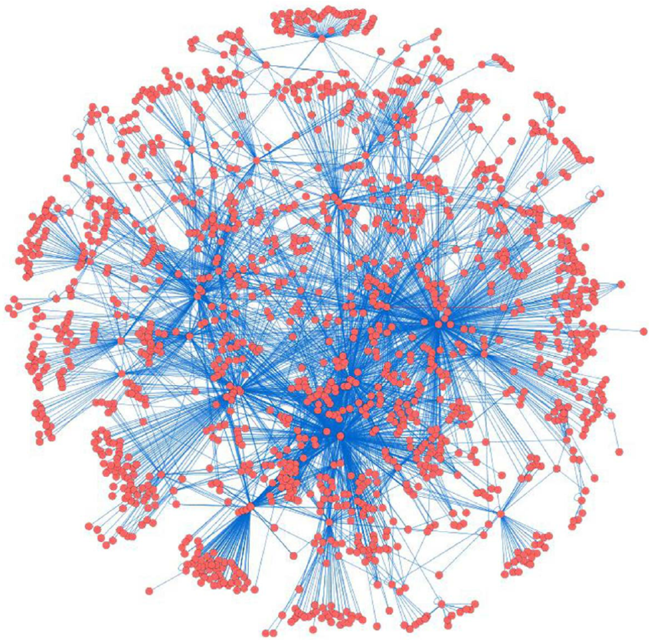
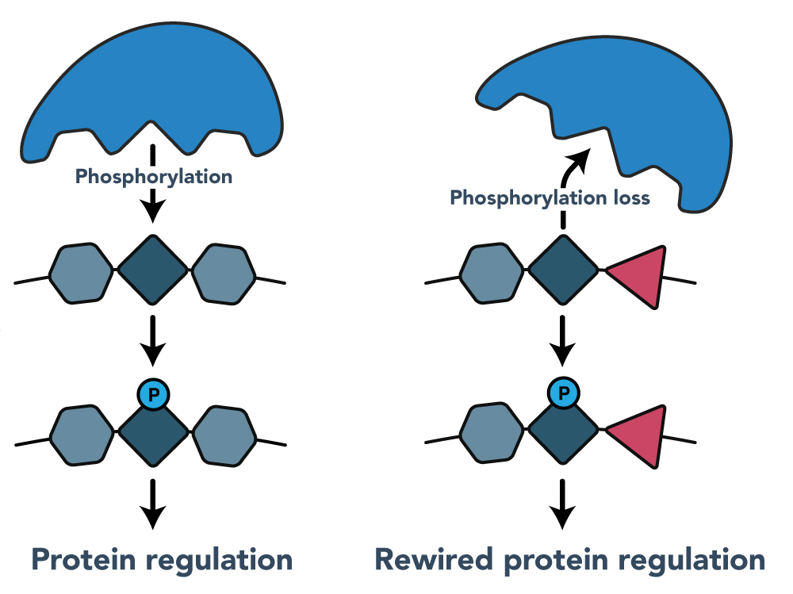
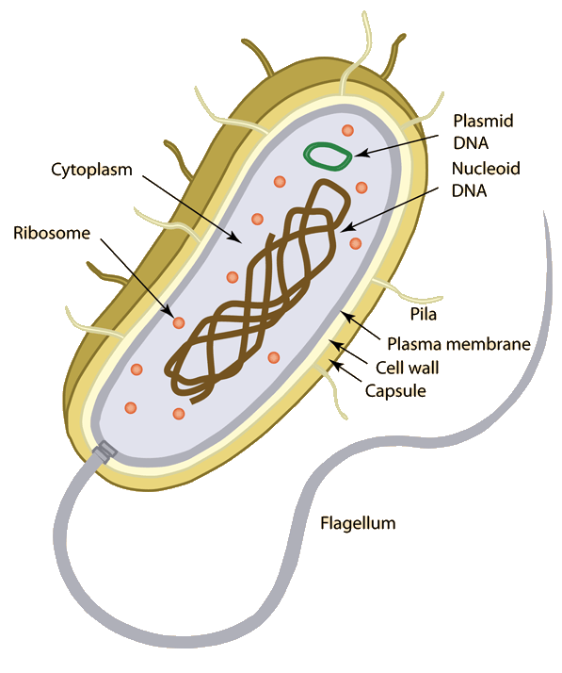
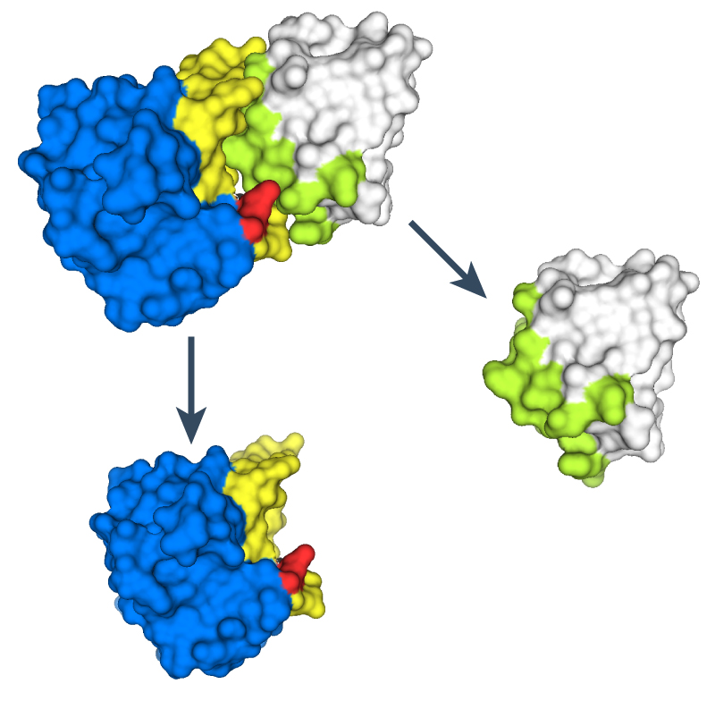
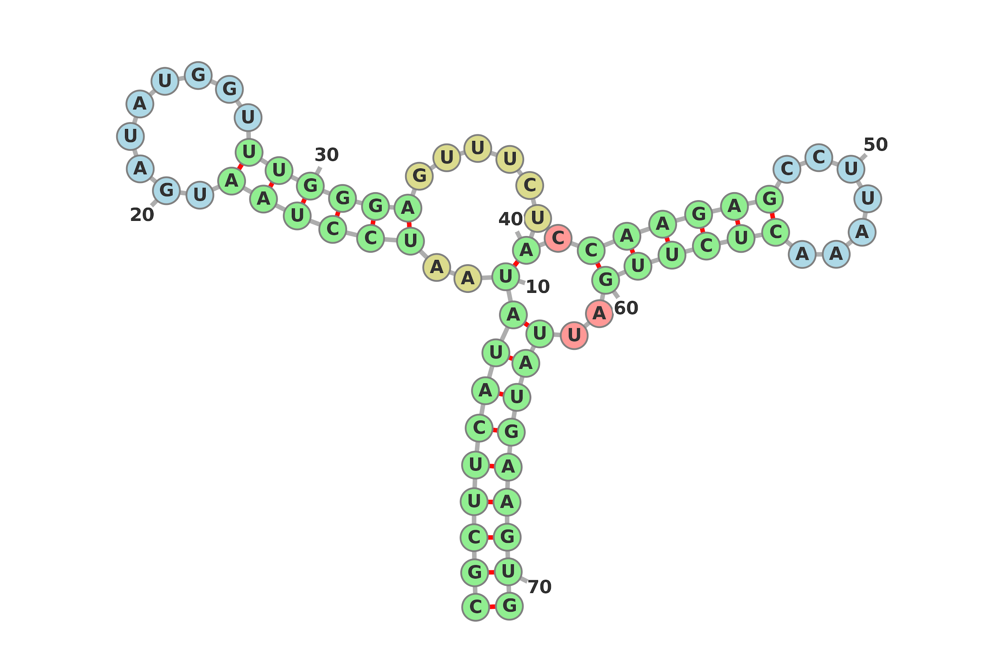
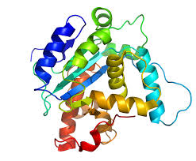
Different Data Types Contributing To the Bitome
Mutations
Metabolism
TRN
PTM motifs
Cellular function
Interface regions
3D Structural Information
2D structures

Slide 18
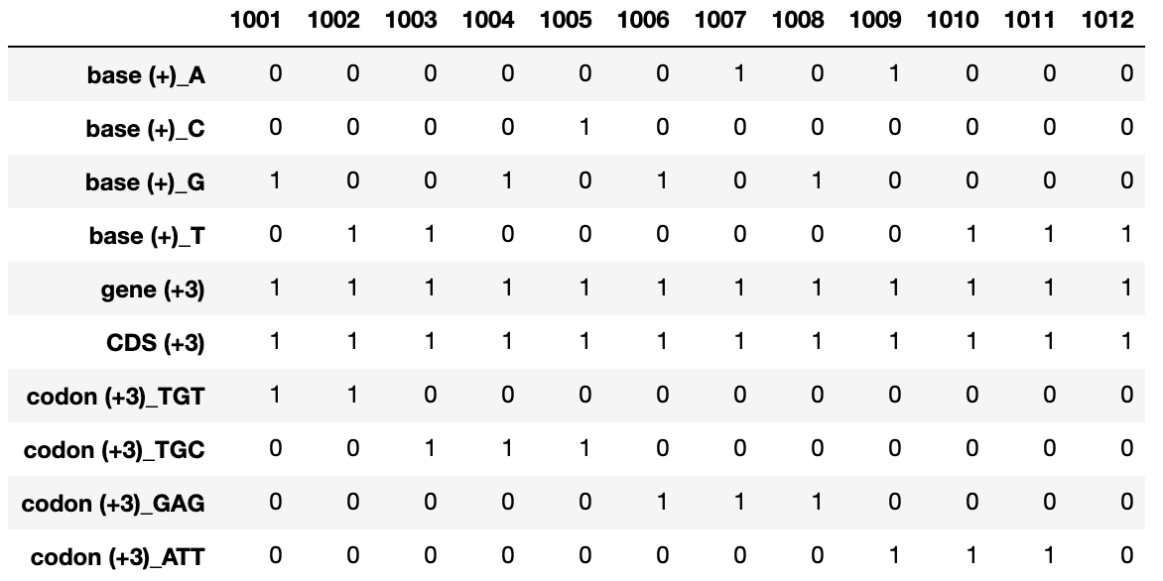
Bitome Matrix
Notes:
one can use such information to visualize the sequence in a form of sparse matrix, columns denotes the genomic location and rows denote every bit of information that can be gathered, for example first row shows the exact locations where we find ‘A’ base pair

Slide 19
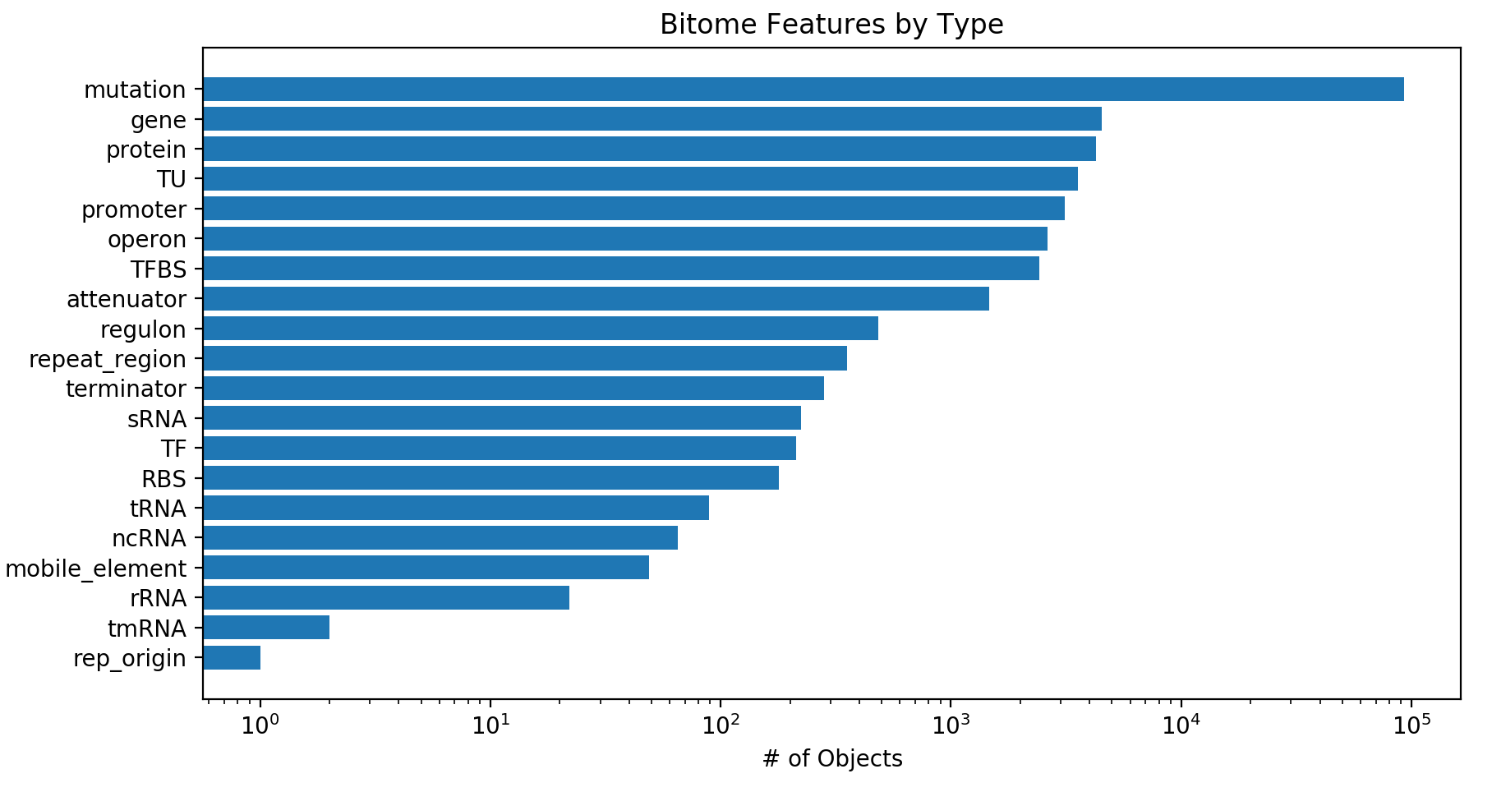
Size of the E. coli K12 Bitome
Notes:
This is the current size and features that we have in the Bitome

Slide 20
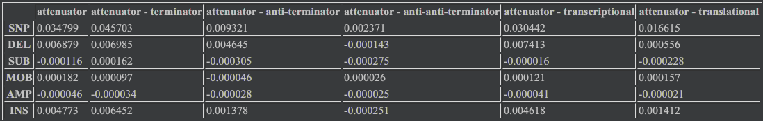
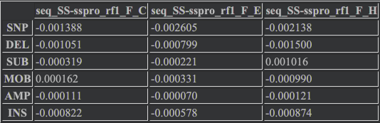
Correlations by Position
Mutation - attenuator
Mutation - secondary structure

Slide 21
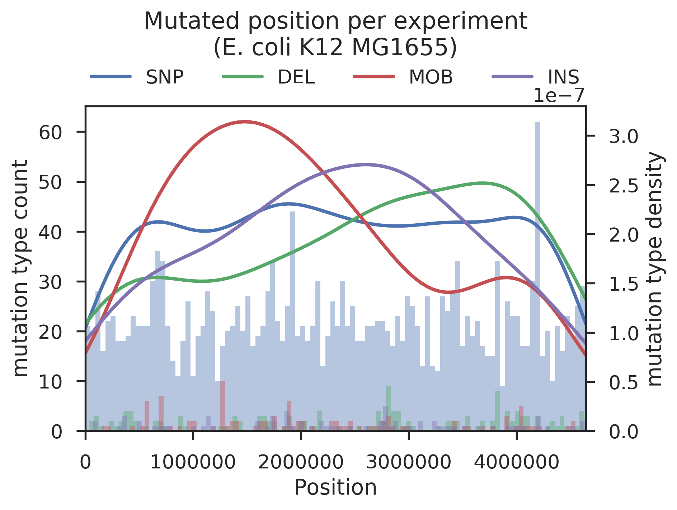
Example: quantifying mutations at each genomic location
Notes:
example is how we interpret mutation data at each genomic location, graph shows the count of particular mutation at each genomic location. Having such a graph easily shows which mutation type is concentrated at what genomic region.
mobile elements

Slide 22
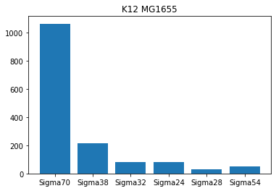
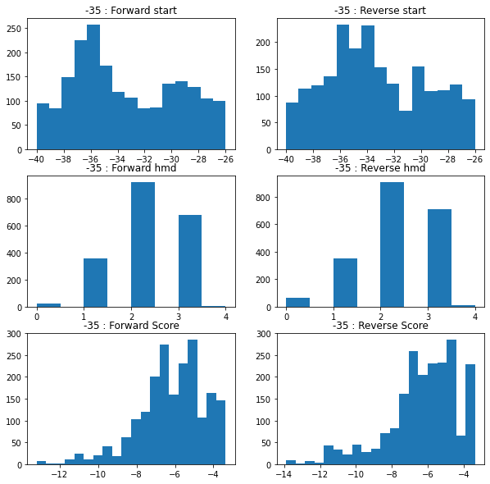
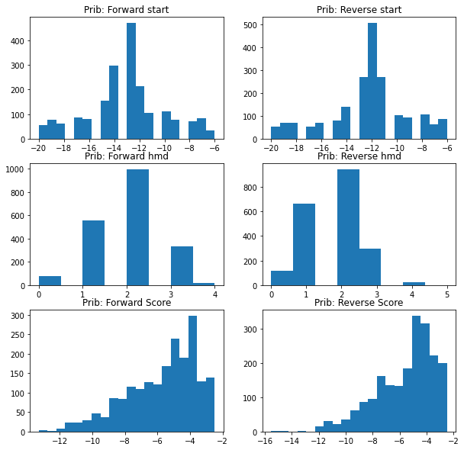
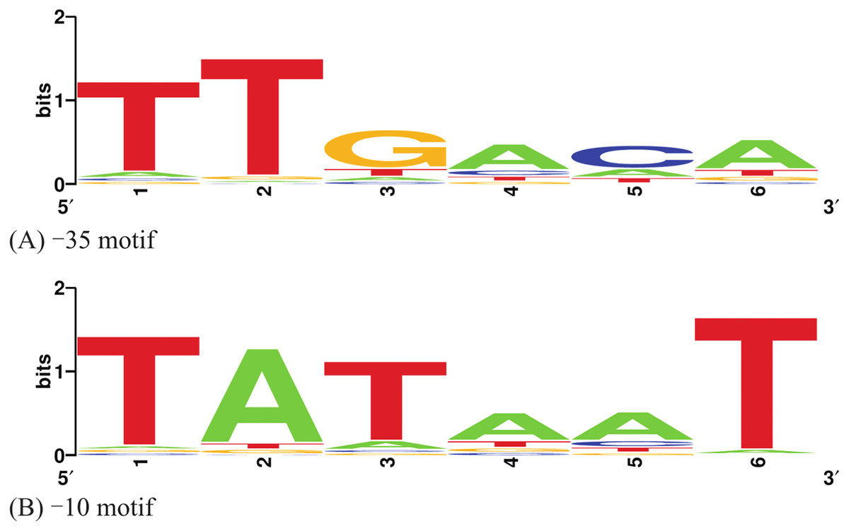
Sigma motif matches consistent with expected locations
Sigma 70 motif match result
Count
Consistent results between + and - strands
Notes:
To match and compute sigma factor related features, we can use motifs of -10 and -35 boxes for 6 sigma factors that have enough data to generare PSSMs.
The example here is the motif for sigma factor 70, also known as RpoD.
The histograms presented here show that the matching result is consistent with theoretical locations.

Slide 23
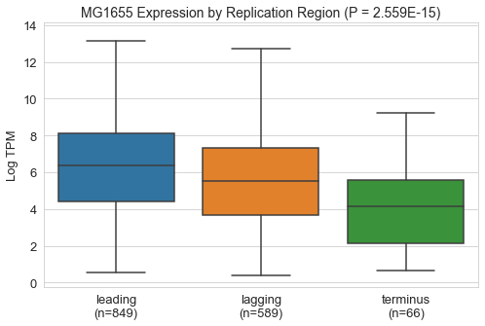
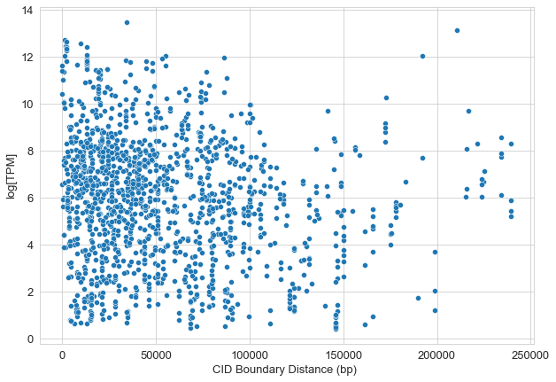
Genome Organization vs Expression
2. Explore features/targets

Slide 24
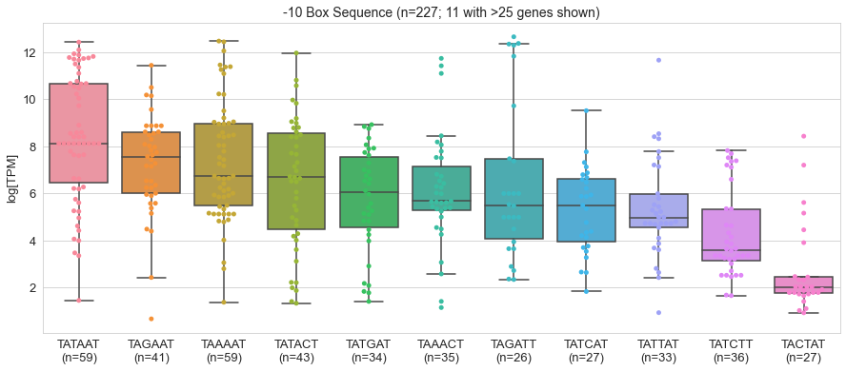
-10 Box vs Expression

Slide 25
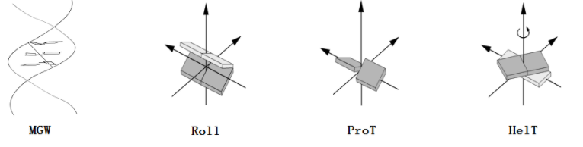
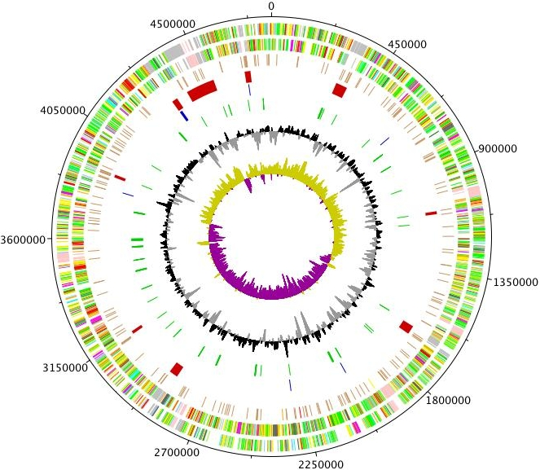
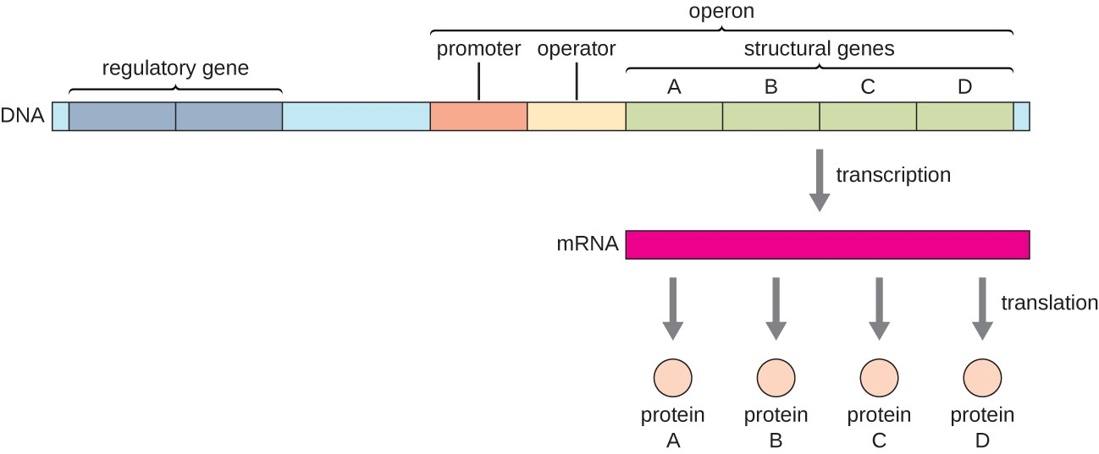
Many more features that influence transcription can be quantified
Promoter Element Motifs
DNA Shape
Genome Organization

Slide 26
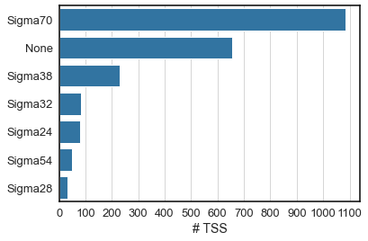
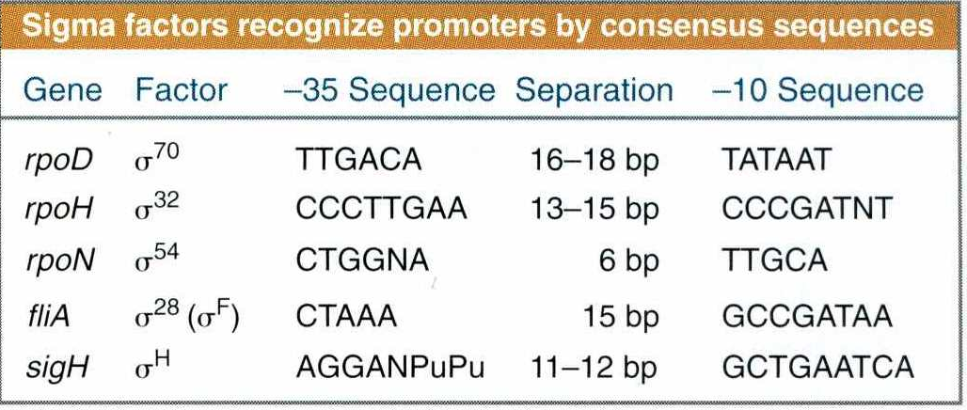
TSS subtypes primarily determined by sigma factor
https://bionumbers.hms.harvard.edu/bionumber.aspx?id=106933

Slide 27
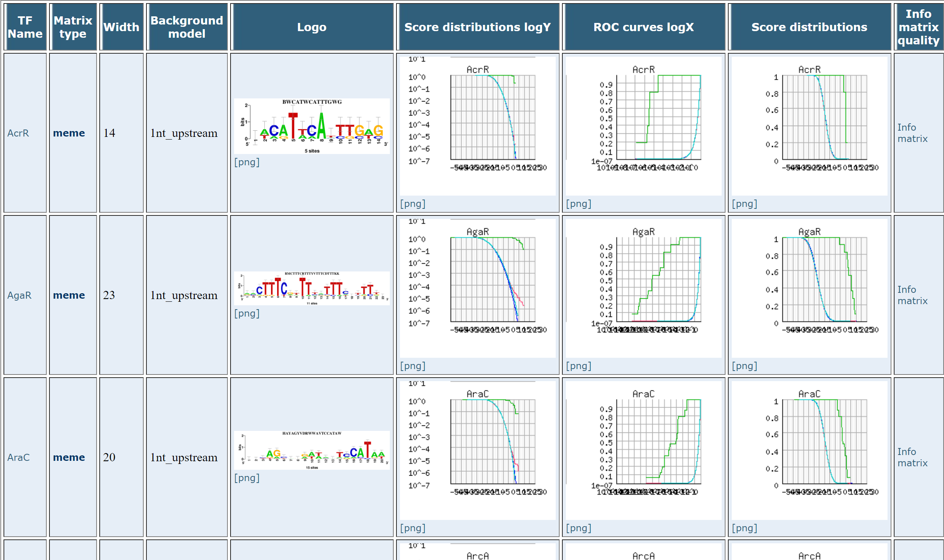
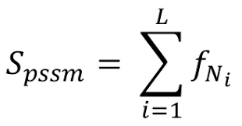
Motifs of TF binding sites
RegulonDB is a comprehensive electronic resource about regulation of transcription initiation of Escherichia coli K-12 with decades of knowledge from classic molecular biology experiments, and also from high-throughput genomic methodologies. The database contains information of more than 70 TF binding sites motifs from ChIP-seq and gSELEX experiments.
Motif scores are computed using PSSMs, higher score indicates higher log odds likelihood of motif existence.
PSSM: position specific score matrix
Notes:
Initially, the prediction only uses ChIP motif features of binding sites.

Slide 28
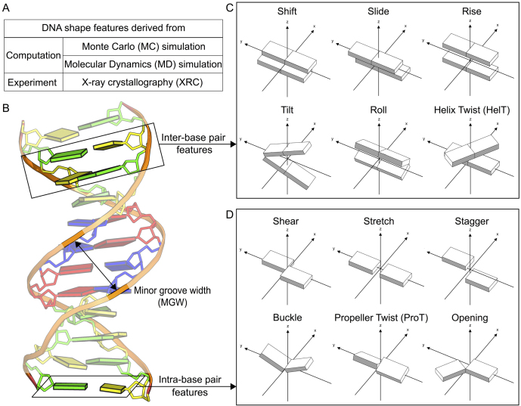
HelT, Roll, MGW, ProT,EP
+
Shift, Slide, Rise, Tilt, Shear, Stretch, Stagger, Buckle, Opening
14 shape features in total

Slide 29
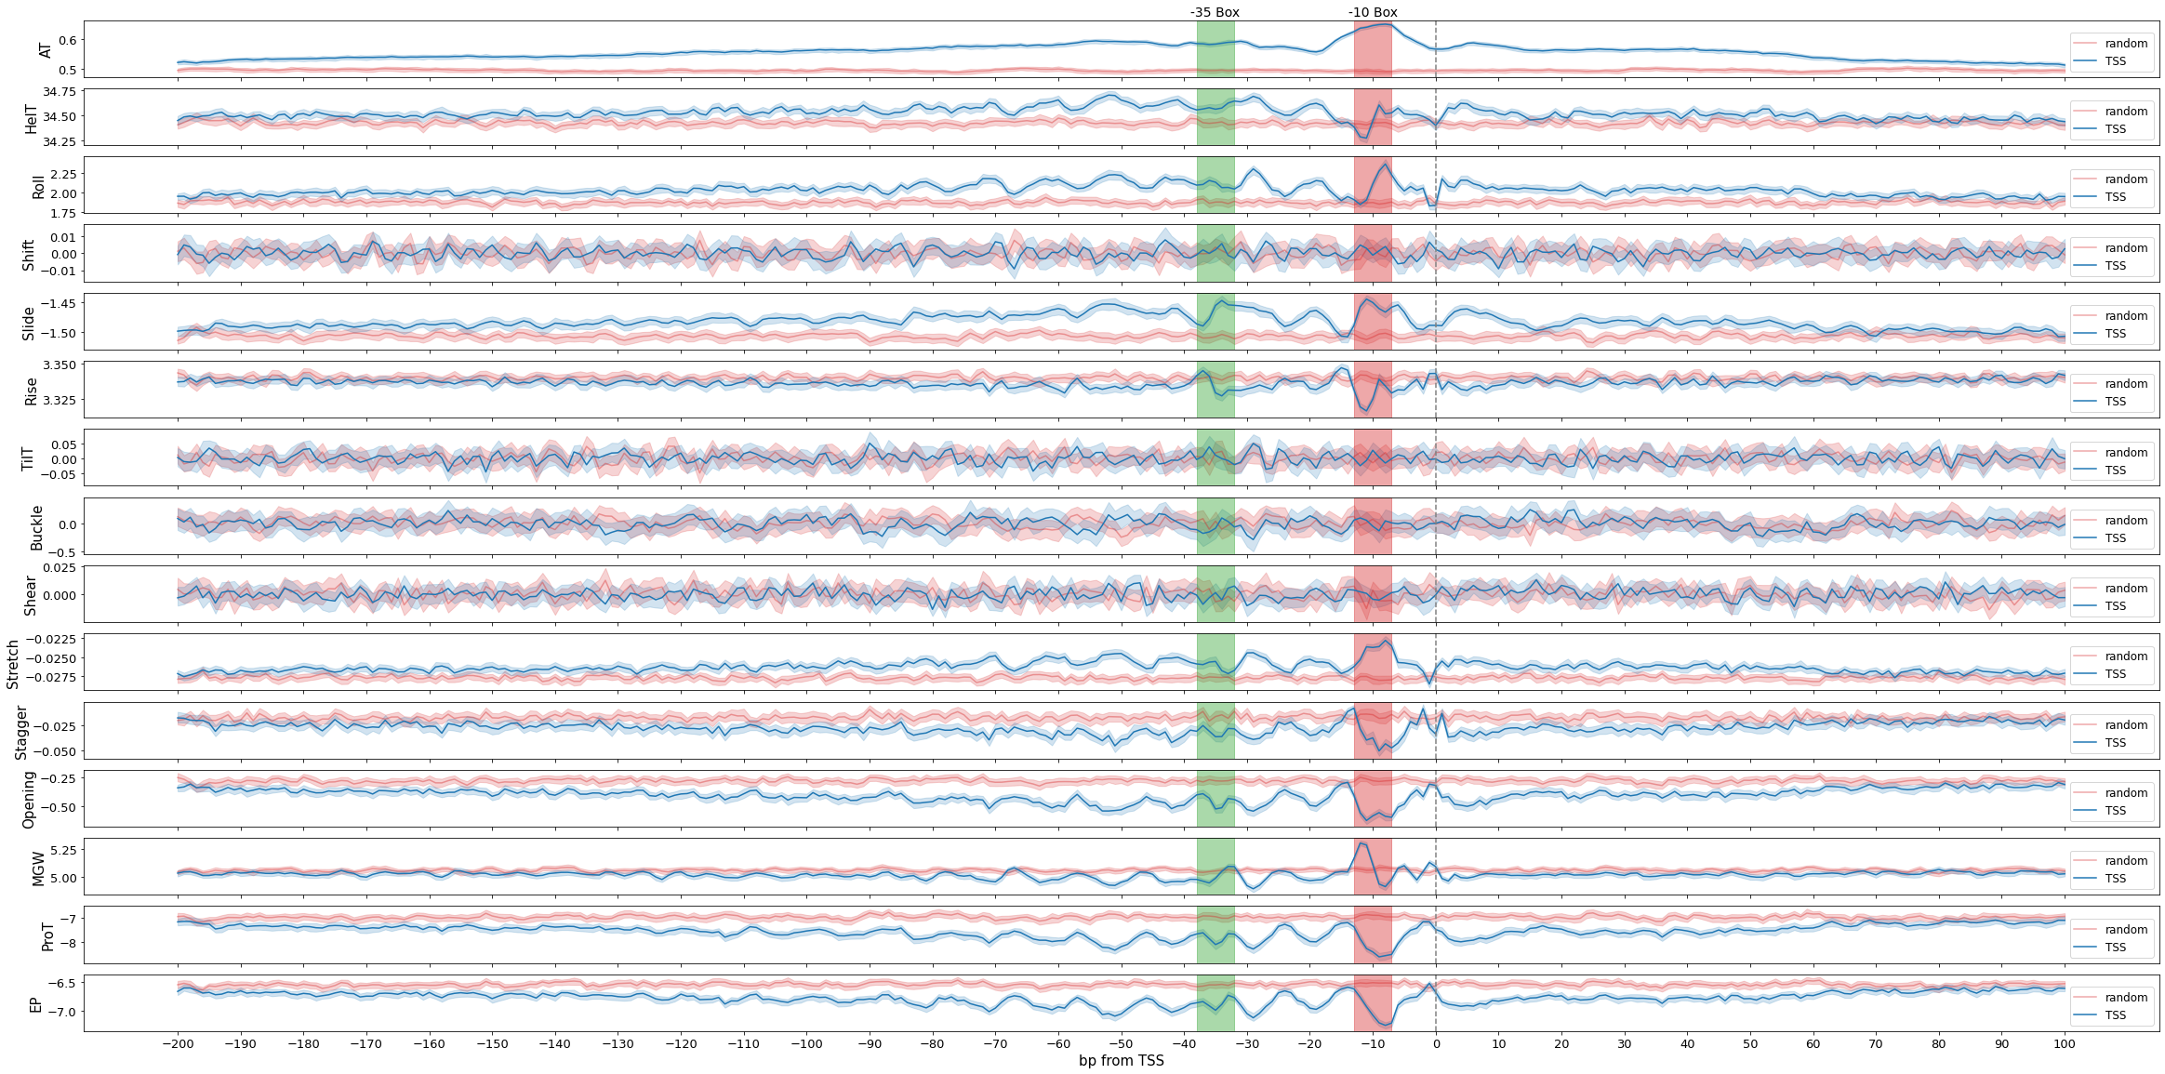
DNA shape features of bacterial promoters

Slide 30
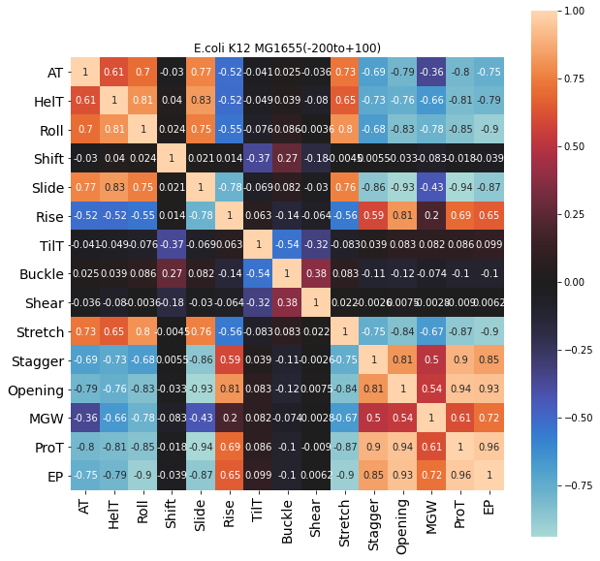
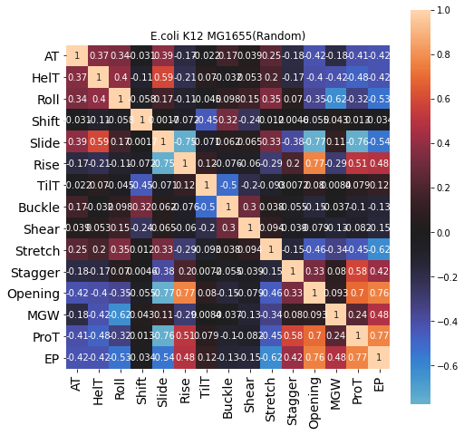

Slide 31
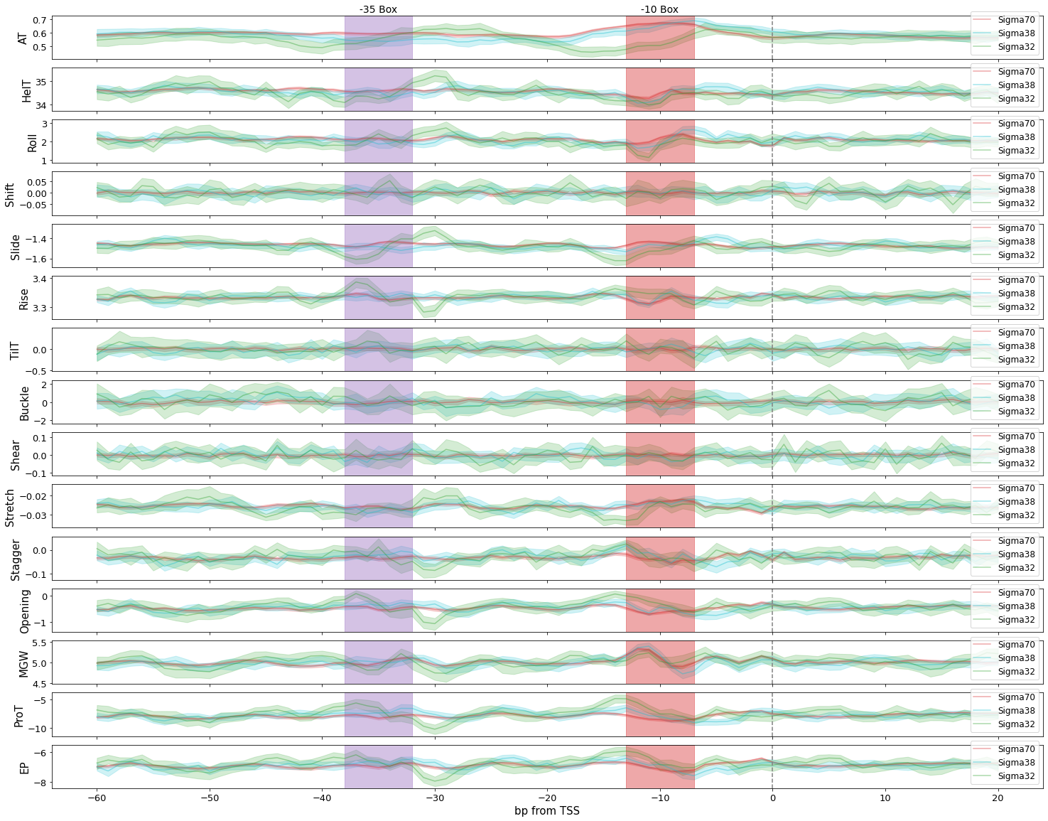
-60 to + 20 at TSS, for TUs regulated by different Sigma factors

Slide 32
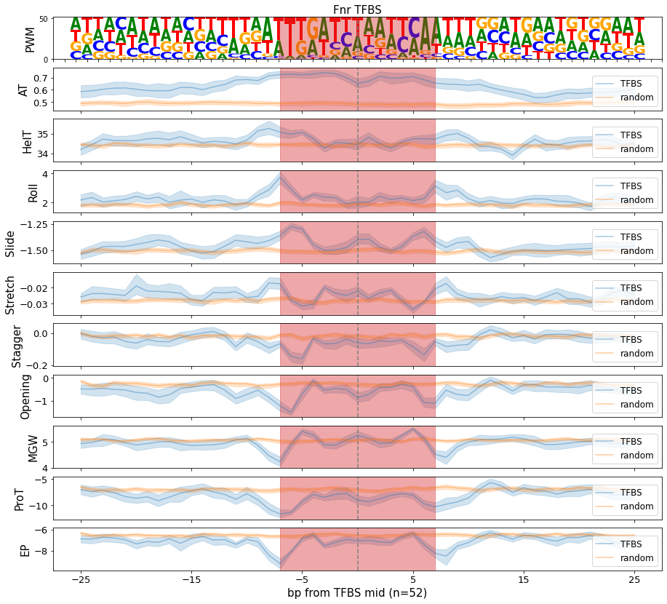
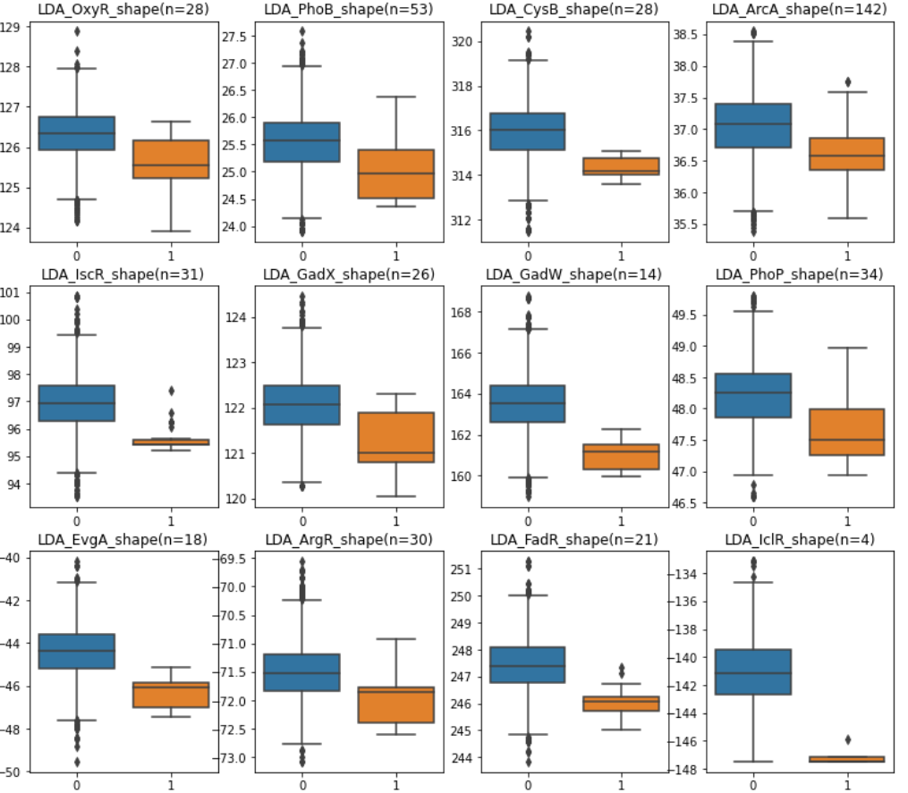
DNA Shape Vectors provide distinguishing features
Characteristic shape features at TFBS
LDA applied to reduce feature dimensions
Notes:
The left panel is the profiling of DNA shape features at TFBS. we can see the Characteristic shape, especially for shape vectors like MGW or propeller twist.
And LDA was also used to process multivariate shape features, and we can see distinguishing distribution on right panel.

Slide 33
Module 3: The Bitome - Genome Analysis and Machine Learning
Part 2: Building predictive models with genome sequence information

Slide 34
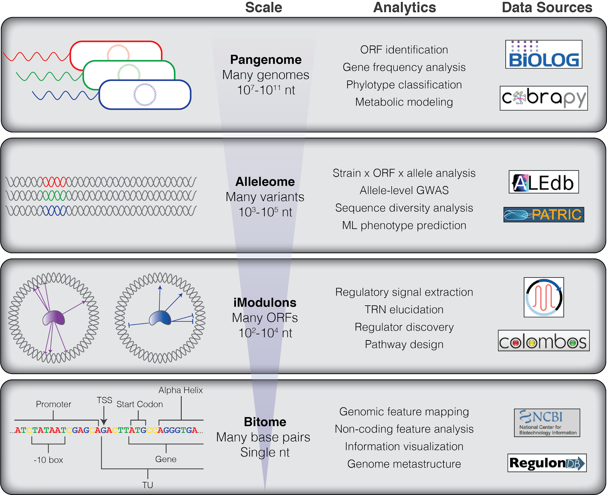
Sequence-Based ML Opportunities are Multi-Scale
predict AMR determinants across multiple pathogens (Hyun et al [2020])
identify independently regulated gene modules (Sastry et al [2019])
predict adaptive mutations and essentiality (Lamoureux et al [2020])

Slide 35
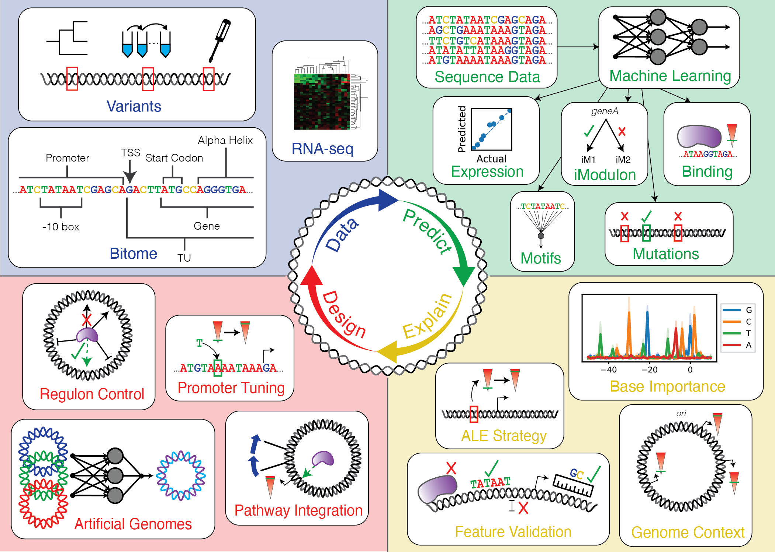

Slide 36
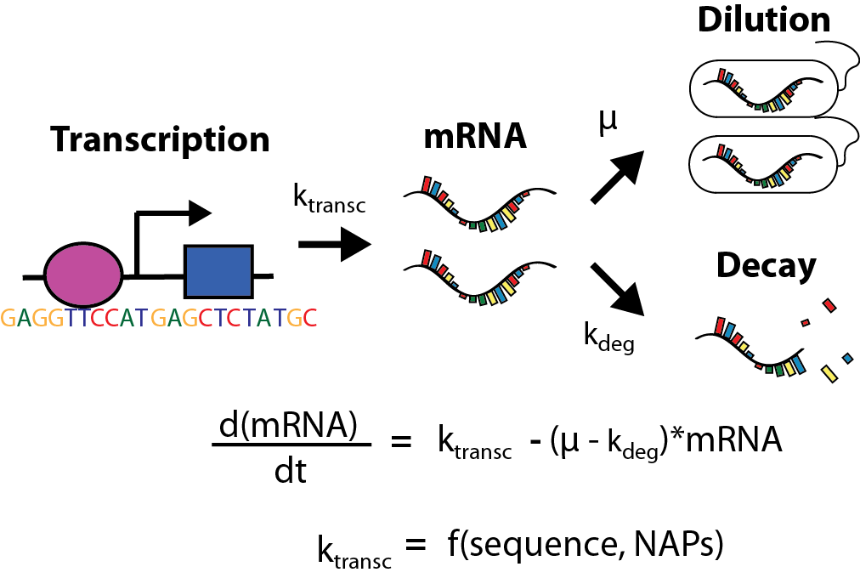

mRNA control, a complex system
Example: RNAP binding
Machine Learning

Slide 37
Predicting Gene Expression from Sequence Features
Research question: can we quantitatively predict gene expression levels from sequence features?
Important to:
Enable prediction of transcriptomic state for any strain for which we just have genome
Reveal specific sequence-based features that are predictive of expression
Open door for expression tuning, synthetic biology, rational design of regulatory networks

Slide 38
ML Workflow for Predicting Expression
Select features, targets, and samples
Explore relationships between features and targets
Train regression models to predict expression
Explain performance of best regression models
Repeat as needed

Slide 39
“Classical” Features Influencing Transcription
Features, Targets, Samples
-10 box location and sequence
-35 box location and sequence
TF binding site presence/absence
5’ UTR length/GC content
Leading/lagging strand
TSS base
Spacer length/GC content
TU length/GC content
Chromosome interacting domain
...and many more
Use all of them!
Let the models decide which are actually predictive
Mejia-Almonte et al (2020) Nature Reviews Genetics

Slide 40

Wild-Type Expression as Target
Features, Targets, Samples
Our expression compendium for E. coli MG1655 is PRECISE 2.0
We only want to consider wild-type RNAseq samples
No ALE endpoints
No genomic KOs
Cannot expect models to understand expression changes due to “unnatural” causes

Slide 41


Genes vs Transcription Units
Features, Targets, Samples
Transcription begins at transcription start sites (TSS) which define the upstream end of a transcription unit
TUs contain multiple genes
Genes may be part of multiple TUs
How can we reconcile promoter features (TU level) with our RNAseq data targets (gene level)
-> Consider genes that are associated with just a single TSS (still >2000 such genes in E. coli)
Mejia-Almonte et al (2020) Nature Reviews Genetics

Slide 42


Distribution of Expression Targets
2. Explore features/targets
How does gene expression vary?
How we do choose the target gene expressions from a large gene expression compendium?
How does gene expression vary with respect to features that we want to use?

Slide 43


Predicting expression from sequence
Can we use the promoter sequence to predict median PRECISE 2.0 gene expression?
Rudimentary model:
Random forest regressor
-50 to +10 from TSS
Compute PWM for genes with alternative TSS
R²: 0.59

Slide 44

Raw Sequence Model Learns Promoter Structure
4. Explain performance
The raw sequence based model identified the critical base pairs in the promoter region without being explicitly told
We also see importance of specific bases in the spacer region
Common theme: explaining an ML model can yield unexpected insights

Slide 45


Sequence models prone to overfitting
Large train-test gap
ML improvements (e.g. hyperparameter optimization) not helping
Further improvements would require careful feature engineering
How best to represent features?

Slide 46

Model/Normalization Selection
3. Training models
Test models that span a range of complexities
Combination of:
A linear model
A support vector model
A random forest
A neural network
This applies to both classification and regression problems
Also try different feature/target normalizations

Slide 47

Raw Sequence vs Summarized Features
The single most important step for any ML workflow
Raw sequence:
Pros
Lets the model learn its own features
Very easy to implement
Cons
Large number of features (prom length x 4) can lead to overfitting
Doesn’t account for variance in key feature locations
Summarized features (e.g. motifs):
Pros
Uses biologically-familiar features
More customizable
Cons
More challenging to implement
Can be more dependent on experimental annotation availability
vs

Slide 48

CNNs may address downsides of raw sequence prediction
CNNs (convolutional neural networks) are a popular type of neural network primarily used in image analysis
Can handle DNA sequence as one-hot encoded “image”
Filter/kernel is convolved across image - thus exact placement of important features is not required
Input can have multiple “channels” - e.g. features calculated from sequence
Non-sequential features can be added in mid-stream
Agarwal and Shendure (2020) Cell Reports

Slide 49
Building a CNN for TSS classification
Create N_{neg} negative examples from random base within +/- 50 bp of real TSS
One-hot encode real TSS
-50
+20
-50
+20
8 filters, 6 bp filter size, stride 1
1-D Conv
Pool size 12, stride 12
Dense (64)
Dense (8)
Custom F-beta loss function
TSS probability

Slide 50


Trends are easy, structure is hard
ML good at identifying smooth associations with little data
e.g. Better -10 box, more expression
However, promoters have ‘types’ and nonlinear behaviors
Even with good features, learning structure is hard
Need a lot of data
https://www.nature.com/articles/s41598-017-18648-5

Slide 51

Biophysical promoter model
Thermodynamic model based on binding favorability
Einav T, et al. Proc Natl Acad Sci USA. 2019 Jul 2;116(27):13340-13345.

Slide 52


Application: Understanding iM structure
Mystery: Some global regulators break into multiple iModulons but same motif - why?
Case study: Crp (cAMP receptor protein)
Literature Observation: Crp has 3 classes of binding
Class I:
Crp by itself
Upstream of -35 box (-61bp)
Interacts with alpha subunit of RNAP
Class II:
Crp by itself
Adjacent to -35 box (-41bp)
Interacts with distinct region of RNAP
Class III:
Crp with other proteins
Hypothesis: Does binding location explain iMs?

Slide 53

Crp1 and Crp2 iM genes have distinct binding sites
Methods: Collected Crp binding site locations from RegulonDB for iM genes
A: Yes, Crp1 and Crp2 actually seem to be Class I and Class II Crp binding types
Binding sites line up perfectly with canonical Class I (-61bp) and class II (-41bp) sites
So, Crp not only has two different binding modes, but these result in two different transcription activities (iMs)
i.e. Not one big regulon with a messy iM breakdown, but rather Crp1 and Crp2 iMs are physiologically meaningful and functionally separate modes of Crp activity
Class I
Class II

Slide 54


Mutants of CRP affect iM as expected
Mutants introduced altering Crp binding activity
Ar1 disrupts both Class 1 and Class 2
Ar2 disrupts only Class 2
Ar1Ar2 double mutant affects both
Q: Why doesn’t everything get activated together as Crp itself gets activated?
A: The sites may have different activity effects on the promoter
Ar2
Ar1
https://www.ncbi.nlm.nih.gov/pmc/articles/PMC5957442/

Slide 55


Biophysical model explains Crp iM activity behavior
v₁ = k⁺ (CrpSites₁ - Crp_{free}*Site₁/K_{d,1})
v₂ = k⁺ (CrpSites₂ - Crp_{free}*Site₂/K_{d,2})
Constructed a Mathematica mass action model describing Crp binding to two distinct sites
One high affinity/effectiveness (low Kd)
One low affinity/effectiveness (high Kd)
Simulated equilibrium site saturation at different activation levels of Crp
Resulting model matches iM behavior
At low Crp activity, the high activity binding site dominates
At high Crp activity, high activity binding site is saturated and the low affinity takes over
Take home: Biophysical models can reproduce observed data
Class II mutant
Site 2 Saturation
Class II mutant
Site 1 Saturation

Slide 56


Logistic Regression Classification to predict the TRN from Promoter Sequence
Simple and robust linear model
Small overfitting and good interpretability
Binary target labels 0 and 1 ( in or not in the regulon )
Sigmoid function
Notes:
The machine learning model is logistic regression classifier. Good interpretability as it is linear.

Slide 57

ChIP motifs are helpful but not sufficient to predict ICA TRN
Initial modeling results
0.8 good model cutoff
0.5 baseline cutoff
Area under ROC curve, receiver operating characteristic curve, used to assess model performance.
Notes:
The x axis is the list of ICA regulons, and y axis is test score computed by area under ROC curve.
State cutoff, state ICA names. Highlight a few good and bad examples.

Slide 58






FNR Case Study
Fnr-ChIP
Fnr-1
Fnr-2
NarP-ChIP
NarL-ChIP
https://www.ncbi.nlm.nih.gov/pmc/articles/PMC3688515/
Notes:
So we start with Fnr, it is a global regulators with several regulation types, and ICA TRN has it’s co-gulagtion with NarL, NarP and ihf.
On right panel, those are motifs used for FNR ICA Regulons.

Slide 59




Feature importance is consistent with regulator enrichment.
Fnr+IHF+gcvB
(n=8)
Fnr+NarL
(n=12)
Fnr+NarLP
(n=23)
Notes:
The predictions of 3 well annotated ICA regulons are quite accurate.
Feature importances of predictive models are assessed with shapley plots.
Shap value is used to assess a player’s contribution in cooperative game theory, and here it is used to assess a feature’s importance in predictive models.
The x axis is the Shap values. The color gradient shows the feature value’s distribution, blue to red, low to high.
Give an example of a dots in Shap plots.

Slide 60



ArcA Case Study: motif diversity
ChIP
2DR
3DR
4DR
For ArcA box, additional Direct Repeat elements beyond 2DR was found by searching with 10bp PWM, 3DR and 2DR are predominant.
https://www.ncbi.nlm.nih.gov/pmc/articles/PMC3798270/
ChIP motif PSSM and Direct Repeat PSSM, ChIP motif matches part of 2DR motif
Notes:
Unlike Fnr, the prediction of ArcA ICA regulon works poorly, and the overlap between 2 types of regulons is small. And better characterizing of binding motif might help improve prediction. One interesting finding in literature is that ArcA’s binding sites have motif diversity, which ChIP motif and ChIP regulon missed.

Slide 61

DR elements match results
Green: Above cutoff
Orange: Below cutoff
Cyan: experimentally determined sites
Cutoff is the average score of annotated DR elements that were experimentally determined.
Notes:
This is an example of matching DR elements to the promoter sequence.

Slide 62



DR features boost performance for ICA TRN classification
ArcA ICA Regulon
ArcA Regulon Prediction
AUC_ROC
ArcA ChIP Regulon
ICA_Regulon ChIP_Regulon
ICA_Regulon ChIP_Regulon
Notes:
Then, we compare the performance of prediction with DR motif features and old ChIP motif features.
We can see that DR features boost the performance of ICA regulon prediction alot. The prediction of ChIP regulon changes little.
And the feature importance assessed with shap value shown on right panel tells us that 3DR is most important for ICA regulon and 2DR is most important for ChIP regulon.
It’s quite reasonable to observe that, since 2DR and 3DR are most predominant ones, and ChIP motif is partially consistent with 2DR motif.

Slide 63
Summary
Many different data types and functional annotations can be mapped to individual base pairs in the genome
The information in the genome can be quantified to enable quantitative prediction of function
Many options exist for both 1) how to quantify sequence information and 2) how to build machine learning models with quantified DNA data
Feature engineering is key to building good performing machine learning models when data is limited
Biological mechanisms can be integrated directly in models or observed through variable importance analysis

